Slide 1

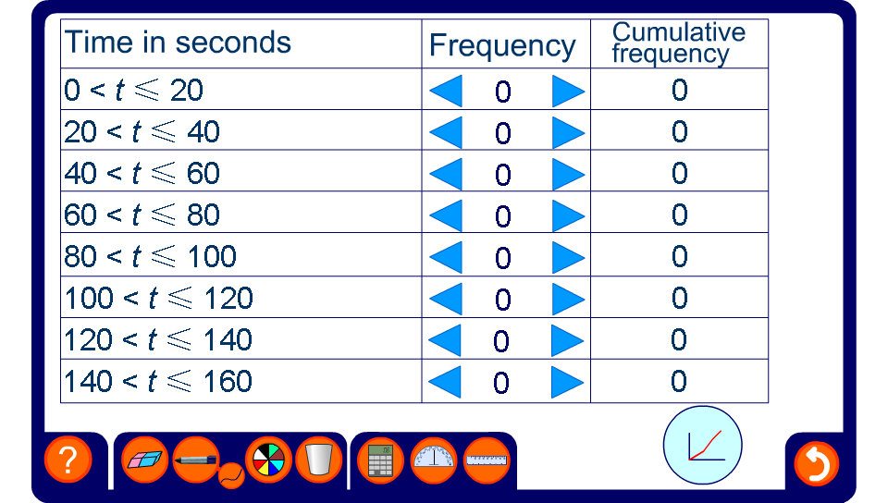


Cumulative frequency graph of results
Notes:
Enter the data. Press the chart icon to see the graph plotted.

